Slide 1
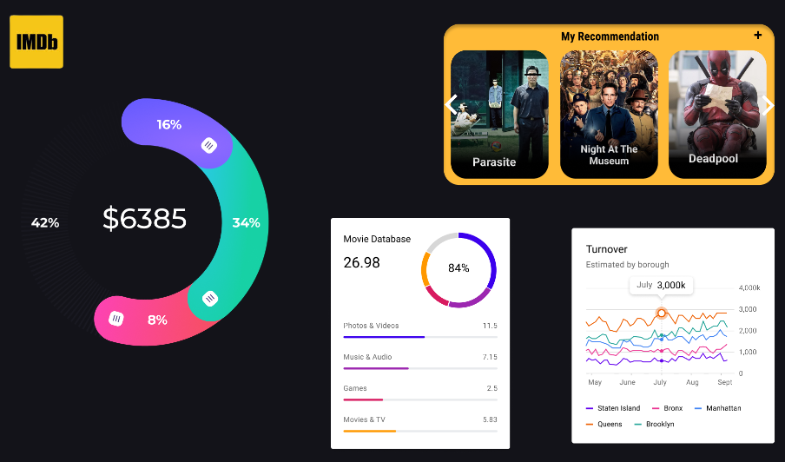
IMDB MOVIE ANALYSIS
By Drustant Metar

Slide 2
Project description
The project's goal is to investigate the elements that greatly affect a film's IMDB success, which is mostly determined by its high ratings. In order to help filmmakers, producers, and financiers make educated decisions for their next productions, a variety of film variables will be analyzed, including genre, budget, cast, director, release date, and more.

Slide 3
Approach
Download the dataset and open into the excel sheet.
Find out the null values, empty values, duplicate values and clean it.
Use filter, pivot table, sum if, average if, count if and other functions to give answer of asked questions.
To make a proper solution and meaningful data representation.
Create report in ppt format and submit the project.

Slide 4
Tech-stack used
Google drive
Mobile hots-spot for internet
Microsoft Excel for analysis
Microsoft Power point

Slide 5
insights and result
Cleaning The Data
One of the most crucial things to do before continuing with the analysis is cleaning.
To do this, apply the knowledge you have acquired thus far. (Removing null values, dropping columns, etc.)
1. Downloaded the dataset and made sense of the information offered.
2. During the download, a unique character emerged in the data set. Thus, I opened the Excel file in CSV format (comma separated files) and saved it as an Excel work book.
3. At this point, the analysis was conducted using Excel.
4. Removed duplicate values from the dataset after checking for them.
5. Next, examine the null values and remove any that don't belong in the necessary columns.

Slide 6
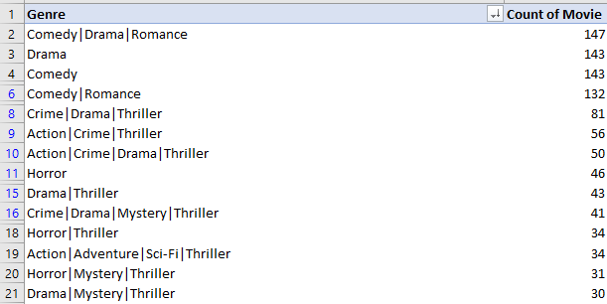
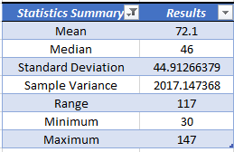
Task 1: Movie genre analysis
Task: Determine the most common genres of movies in the dataset. Then, for each genre, calculate descriptive statistics (mean, median, mode, range, variance, standard deviation) of the IMDB scores.(Top 20 most common genre)

Slide 7
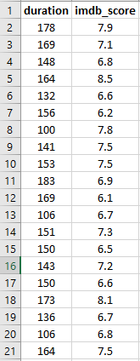

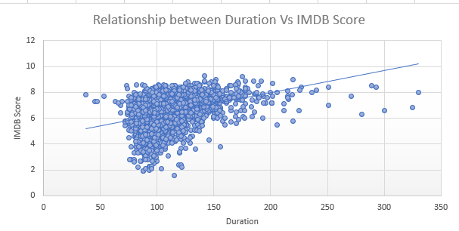
Task 2: movie duration analysis
Task: Analyze the distribution of movie durations and its impact on the IMDB score.
Total rows are 3782

Slide 8
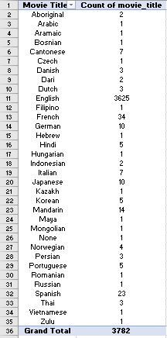
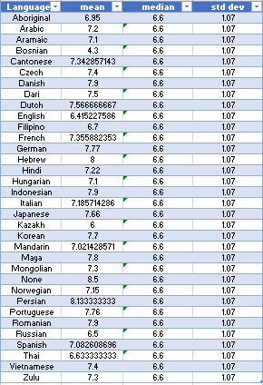
Task 3: language analysis
Task: Situation: Examine the distribution of movies based on their language.

Slide 9
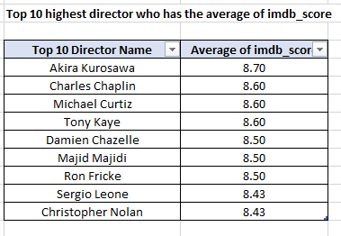

Task 4: director analysis
Task: Identify the top directors based on their average IMDB score and analyze their contribution to the success of movies using percentile calculations.
=LARGE(Table1[Average of imdb_score],1)
=PERCENTRANK(Table1[Average of imdb_score],E16)
=PERCENTILE(Table1[Average of imdb_score],E17)

Slide 10

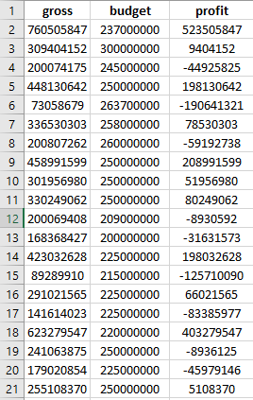
Task 5: budget analysis
Task: Analyze the correlation between movie budgets and gross earnings, and identify the movies with the highest profit margin.
Total rows are 3722

Slide 11
Drive link
Excel link: https://docs.google.com/spreadsheets/d/1V4JCpOFqLtrtzI8jSPmG_gbpSKSL6XEa/edit#gid=529165265
Power Pointhttps://drive.google.com/file/d/1EWs3sqnpjfsOqGTsRDQmUHax4JVMyNe2/view?usp=drive_link

Slide 12
The end
Thank you!!!

